Slide 1
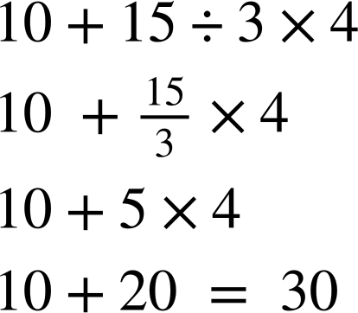
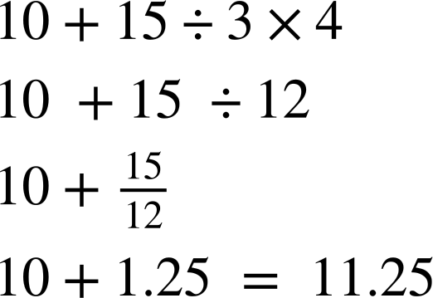
Priority of operations with positive integers
Task A: Multiplication, division, addition and subtraction
Work out the answers to the following. Ensure to show all your working out.
12 + 6 × 2
100 − 20 ÷ 5
c) 3 × 10 − 24 ÷ 8
12 + 12 = 24
24
8
30 −
30 - 3 = 27
100 − 4 = 96
2) Sam and Sofia do the same calculation differently. Whos is correct? Explain what they should have done differently.
Sam
Sofia
Sofia should have written 15÷3 as a fraction and then multiply by 4.
3) Fill in the gaps with +, −, ÷ and × so that the calculations are correct.
a) 4 5 + 6 + 7 = 12
b) 4 + 5 + 6 – 7 = 8
c) 4 × 5 + 6 × 7 = 62
d) 4 × 5 – 6 – 7 = 7
e) 4 × 5 – 6 + 7 = 21
4) Fill in the gaps with +, −, ÷ and × so that the calculations are correct.
a) 10 + 2 ÷ 2 - 3 = 8
b) 10 ÷ 2 + 15 ÷ 3 = 10
c) 10 × 2 - 10 ÷ 2 + 2 × 3= 21

Slide 2
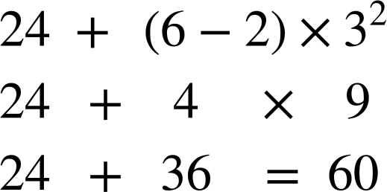
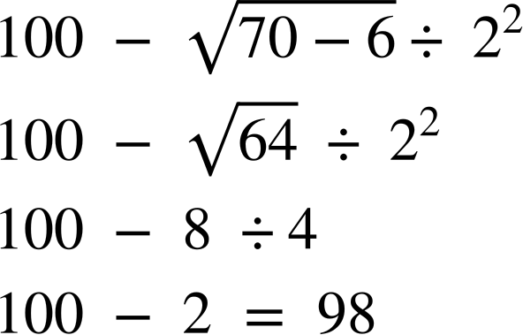
Priority of operations with positive integers
Task B: Brackets, roots and exponents
Work out the answers to the following. Ensure to show your working out.
a)
b)
2) Fill in the gaps with +, −, ÷, × and brackets so that the calculations are correct. You can use more than one pair of brackets.
a) (4 + 5) x (6 + 7) = 117
b) 4 × (5 + 6) × 7 = 308
c) 4 + 5 × (6 + 7) = 69
d) (4 - 5) × 6 + 7 = 1
3) Use exactly four 4s, together with any of the operations ×, ÷, +, √, −, exponents (can be any value) and/or brackets to write calculations giving answers of: 1, then 2, then 3… up to 20. As an example, 8 has been done for you.
These are some examples of how to get each number. There are many more out there!
6 = (4 + 4) ÷ 4 + 4
7 = 4 + 4 − 4 ÷ 4
8 = 4 ÷ 4 × 4 + 4
9 = 4 ÷ 4 + 4 + 4
10 = (44 − 4) ÷ 4
10 = (4 + 4 + 4)−√4.
1 = 4 ÷ 4 + 4 − 4
2 = 4 – ( 4 + 4) ÷ 4
3 = (4 + 4 + 4)÷ 4
4 = (4 − 4) × 4 + 4
5 = (4 × 4 + 4) ÷ 4
11 = (4 ÷ 0.4)+(4÷4)
12 = 4 ×(4 − 4 ÷ 4)
13 = (44 ÷ 4) + √4
14 = 4 × 4 − 4 ÷√4
15 = 4 × 4 − 4 ÷ 4
16 = 4 × 4 + 4 − 4
17 = 4 × 4 + 4 ÷ 4
18 = 4 × 4 + 4 −√4
19 = 4² + 4 − 4 ÷ 4
20 = 4 ×(4 ÷ 4 + 4)
Mathematics in Education and Industry
v2.2

